Slide 1




www.myhealthcheckedplc.com
Investor Presentation | CONFIDENTIAL

Slide 2

Document information
IMPORTANT NOTICE
This document, which has been prepared by, and is the sole responsibility of, MyHealthChecked plc (the "Company"), has been prepared solely in connection with the proposed placing of new ordinary shares of 0.1 pence each in the capital of the Company (the "Placing Shares") and the proposed admission of the Placing Shares to trading on the AIM market of the London Stock Exchange plc (the "Placing"). The Placing does not constitute a public offer of transferable securities in the United Kingdom pursuant to section 85 of the Financial Services and Markets Act 2000 (as amended) (the "FSMA") and, accordingly, no prospectus will be published in connection with the Placing in accordance with the Prospectus Regulation 2017/1129/EU as it forms part of UK domestic law by virtue of the European Union (Withdrawal Act) 2018 (the "Prospectus Regulation").
This document does not constitute or form part of any offer or invitation to sell or issue or any solicitation of any offer to purchase or subscribe for any shares or other securities of the Company nor shall it (or any part of it), or the fact of its distribution, form the basis of, or be relied upon in connection with or act as any inducement to enter into, any contract or commitment whatsoever. This document is not a recommendation regarding the securities of the Company. Recipients should not purchase, subscribe for or otherwise acquire any securities of the Company on the basis of this document or the presentation made in conjunction with this document (the "Presentation").
This document is being distributed only to and is only directed at persons in the United Kingdom who are: (i) "qualified investors" within the meaning of Article 2 of the Prospectus Regulation ("Qualified Investors"), and (ii) persons in the United Kingdom: (a) who have professional experience in matters relating to investments falling within Article 19(5) of the Financial Services and Markets Act 2000 (Financial Promotion) Order 2005, as amended (the "Order"); (b) who are high net worth persons or entities falling within Article 49(2)(a) to (d) of the Order or (c) to whom it may otherwise be lawfully distributed (all such persons together being referred to as "Relevant Persons"). Any person who is not both a Qualified Investor and a Relevant Person should not act or rely on the information contained in this document. If you are in any doubt as to the matters contained in this document (including whether you fall within the definitions of Qualified Investor or Relevant Person), you should consult an authorised person specialising in advising on investments of the kind contained in this document. Any investment or investment activity to which this document relates is available only to Qualified Investors and Relevant Persons.
This document does not constitute or form part of an offer or invitation to issue or sell, or the solicitation of an offer to subscribe or purchase, any securities to any person in any jurisdiction to whom or in which such offer or solicitation is unlawful. This document and its contents are confidential and are being supplied to you for your own information and may not be distributed, transmitted, published, reproduced or otherwise made available to any other person, in whole or in part, directly or indirectly, for any purposes whatsoever. In particular, this document should not be distributed, transmitted, published, reproduced or otherwise made available, directly or indirectly, in, into or from Canada, Australia, Japan, New Zealand, the Republic of South Africa or the United States, its territories or possessions or in any other jurisdiction outside of the United Kingdom where such distribution or availability may lead to a breach of any law or regulatory requirements. The distribution of this document in other jurisdictions may be restricted by law, and persons into whose possession this document come should inform themselves about, and observe, any such restrictions. Any failure to comply with these restrictions may constitute a violation of the laws of the relevant jurisdiction. The securities of the Company have not been, and will not be, registered under the United States Securities Act of 1933, as amended (the "Securities Act"), or under the applicable securities law or with any securities regulatory authority of any state or jurisdiction of the United States or under the securities laws of Australia, Canada, Japan, New Zealand, the Republic of South Africa or any state, province or territory thereof or any other jurisdiction outside the United Kingdom and may not be taken up, offered, sold, resold, pledged, transferred, delivered or distributed, directly or indirectly, through CREST or otherwise, within, into or from Canada, Australia, Japan, New Zealand, the Republic of South Africa or the United States, or to, or for the account or benefit of, any person with a registered address in, or who is a resident or ordinary resident in, or a citizen of such jurisdictions or to any person in any country or territory where to do so would or might contravene applicable securities laws or regulations except pursuant to an applicable exemption. Any securities of the Company will only be offered and sold outside of the United States in "offshore transactions" within the meaning of and in reliance on the safe harbour from the registration requirements under the Securities Act provided by Regulation S promulgated thereunder. The securities of the Company have not been approved or disapproved by the US Securities and Exchange Commission, any state securities commission or other regulatory authority in the United States, nor have any of the foregoing authorities passed upon or endorsed the merits of the Placing or the accuracy or adequacy of this document. Any representation to the contrary is a criminal offence in the United States.
The information contained in this document is provided as at the date of its publication and is subject to updating, completion, revision, amendment and further verification and does not purport to contain all information that may be required to evaluate the Company and/or the Placing. This document contains statements that are, or may be deemed to be, "forward-looking statements". These forward-looking statements may involve substantial risks and uncertainties and actual results and developments may differ materially from those expressed or implied by these statements by a variety of factors. Forward-looking statements are sometimes identified by the use of forward-looking terminology such as "believe", "expects", "may", "will", "could", "should", "shall", "risk", "intends", "estimates", "aims", "plans", "predicts", "continues", "assumes", "positioned" or "anticipates" or the negative thereof, other variations thereon or comparable terminology. These forward-looking statements speak only as at the date of this document. In addition, all projections, valuations and statistical analyses provided in this document may be based on subjective assessments and assumptions and may use among alternative methodologies that produce different results and should not be relied upon as an accurate prediction of future performance. The Company's website nor any website accessible by hyperlinks on the Company's website does not form part of this document or the Presentation, has not been subject to review or verification in respect of the Placing and no reliance may be placed by an investor on any information or opinions expressed on that website.
Except as required by applicable law or regulation, none of the Company, SPARK Advisory Partners Limited and Oberon Capital Ltd or any of their respective directors, officers, partners, employees, agents, affiliates, representatives or advisers undertakes or agrees any obligation to update or revise any forward-looking or other statements or information in this document, whether as a result of new information, future developments or otherwise and none of the Company SPARK Advisory Partners Limited and Oberon Capital Ltd or any of their respective directors, officers, partners, employees, agents, affiliates, representatives or advisers or any other party undertakes or agrees or is under any duty to update this document or to correct any inaccuracies in, or omissions from, any such information which may become apparent or to provide you with any additional information. No statement in this document is intended as a profit forecast or profit estimate (unless otherwise stated).
To the fullest extent permitted by applicable law or regulation, no undertaking, representation or warranty or other assurance, express or implied, is made or given by or on behalf of the Company SPARK Advisory Partners Limited and Oberon Capital Ltd or any of their respective parent or subsidiary undertakings or the subsidiary undertakings of any such parent undertakings or any of their respective directors, officers, partners, employees, agents, affiliates, representatives or advisers, or any other person, as to the accuracy, sufficiency, completeness or fairness of the information, opinions or beliefs contained in this document. Save in the case of fraud, no responsibility or liability is accepted by any person for any errors, omissions or inaccuracies in such information or opinions or for any loss, cost or damage suffered or incurred, howsoever arising, directly or indirectly, from any use of, as a result of the reliance on, or otherwise in connection with, this document. In addition, no duty of care or otherwise is owed by any such person to recipients of this document or any other person in relation to the Presentation. This document and its contents are confidential and you and your directors, officers, partners, employees, agents and affiliates shall treat and safeguard as strictly private and confidential all information contained in this document and any oral information made available at the Presentation. You shall not use this document or the information contained herein in any manner detrimental to the Company. This document contains inside information. By accepting this document and by attending the Presentation you agree not to use all or any of the information contained herein (except to the extent it has lawfully been made public) to deal, advise or otherwise require or encourage another person to deal in the securities of the Company or engage in any other behaviour which amounts to the criminal offence of insider dealing under the Criminal Justice Act 1993 or the civil offence of insider dealing under the Market Abuse Regulation (2014/596/EU) as it forms part of UK domestic law by virtue of the European Union (Withdrawal Act) 2018 or other applicable laws and/or regulations in other jurisdictions.
SPARK Advisory Partners Limited and Oberon Capital Ltd, each of which is authorised and regulated in the United Kingdom by the Financial Conduct Authority, are acting exclusively for the Company and are not acting on behalf of any recipient or reader of this document and will not be responsible to any such person (whether or not a recipient of this document), other than the Company, for providing the protections afforded to their clients or for advising any such person in connection with the Placing or any other matter referred to in this document. Any such person is recommended to seek their own independent legal and investment advice. Neither the receipt of this document, nor any information contained therein or supplied with this document or subsequently communicated to any person in connection with this document either constitutes, or is to be taken as constituting, the giving of investment advice by SPARK Advisory Partners Limited or Oberon Capital Ltd to any person.
By attending the Presentation and/or by receiving this document (whether in hard copy form or electronically), you irrevocably represent, warrant and undertake to the Company, SPARK Advisory Partners Limited and Oberon Capital Ltd that: (i) you are a Relevant Person and a Qualified Investor; and (ii) you have read and agree to comply with, and be bound by, the contents of this notice.

Slide 3




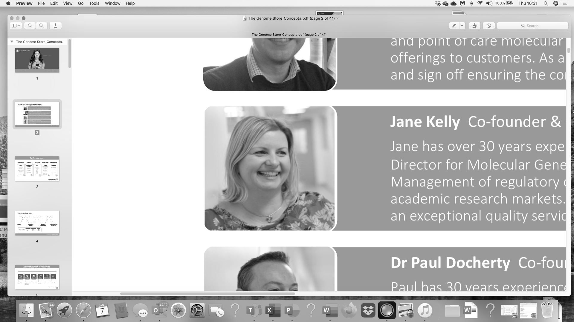









Leadership with proven experience in technical & commercial growth
Presenting
today
Penny McCormick
CEO
Maddy Kennedy
CFO
Dr Karen Whiting
CTO
Amy Howarth
Marketing Manager
Jane Kelly
Operations Manager
Bhavika Patel
Product Specialist
A team building in ambition and experience
With over 75 years of experience in successful commercial and technical biotech programmes
15 years in medical devices plus IVD
Commercial out licensing to £32m deal value
Delivered strong financial growth
Healthcare supplier into Boots and grocery majors for 10+ years
Portfolio development and launch under ISO 13485
Proven CFO for transformational out-licensing, acquisition and IPO
Life science and tech specialties
Digital health portfolio, Alliance Pharma
20 years immunoassay expertise BTB and OTC
Multiple product launches
Programme leadership & delivery
Medicine Management, software development
20 years consumer & retail brand marketing
European marketing teams leadership for international retail brands, including Gap, Uniqlo and Boden.
Proven development of integrated consumer marketing strategies, campaign and brand development and digital marketing
Over 30 years experience in scientific field
Co-founder and Operational Director of Ex5 Genomics and The Genome Store
Operational Management of regulatory compliant Molecular Genetic testing services (ISO 17025 and GCP)
Over 11 years in the scientific industry
Molecular diagnostics, large pharma, CROs actively involved in management, growth and global expansion of SMEs
Focus on the development and optimisation of consumer genetics testing programs
3

Slide 4



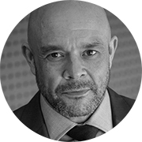



Backed by experienced NEDs and Mercia as major shareholder
Presenting
Experts in commercialisation and investment of IVDs and consumer technology
Adam Reynolds Chairman
Peter Dines
Non-Exec Director
Neil Mesher
Non-Exec Director
Lyn Rees
Non-Exec Director
Chairman, investor and NED portfolio including EKF, Yourgene
COO Mercia Asset Management Plc.
Former MD positions in medical device tech space
CEO Phillips UK & Ireland.
Board member of the Association of British Healthcare Industries (ABPI)
CEO of YourGene Health.
Former CEO and Directorships including Alere, The BBI Group
4

Slide 5

MyHealthChecked Plc
Bringing Simple, Reliable, Affordable health tests to market - now
P
New management team who have built a new strategy in 2020. We have invested to grow in 2021 and beyond
We are seeking to become the UK’s leading B2C POC testing business addressing the high growth structural shift from consumers to use affordable tests delivered to their home, and with a digitally delivered outcome and actionable advice
P
We have added and will further add new tests to our core offering in female fertility
P
Lean, focused and addressing new markets with new tests: cost based managed to ensure a capital efficient operation
P
Exciting partnerships with established UK diagnostic businesses: market launched and under development
P
Agile set up and able move quickly: market responsive
P
5
CONFIDENTIAL | The Genome Store

Slide 6

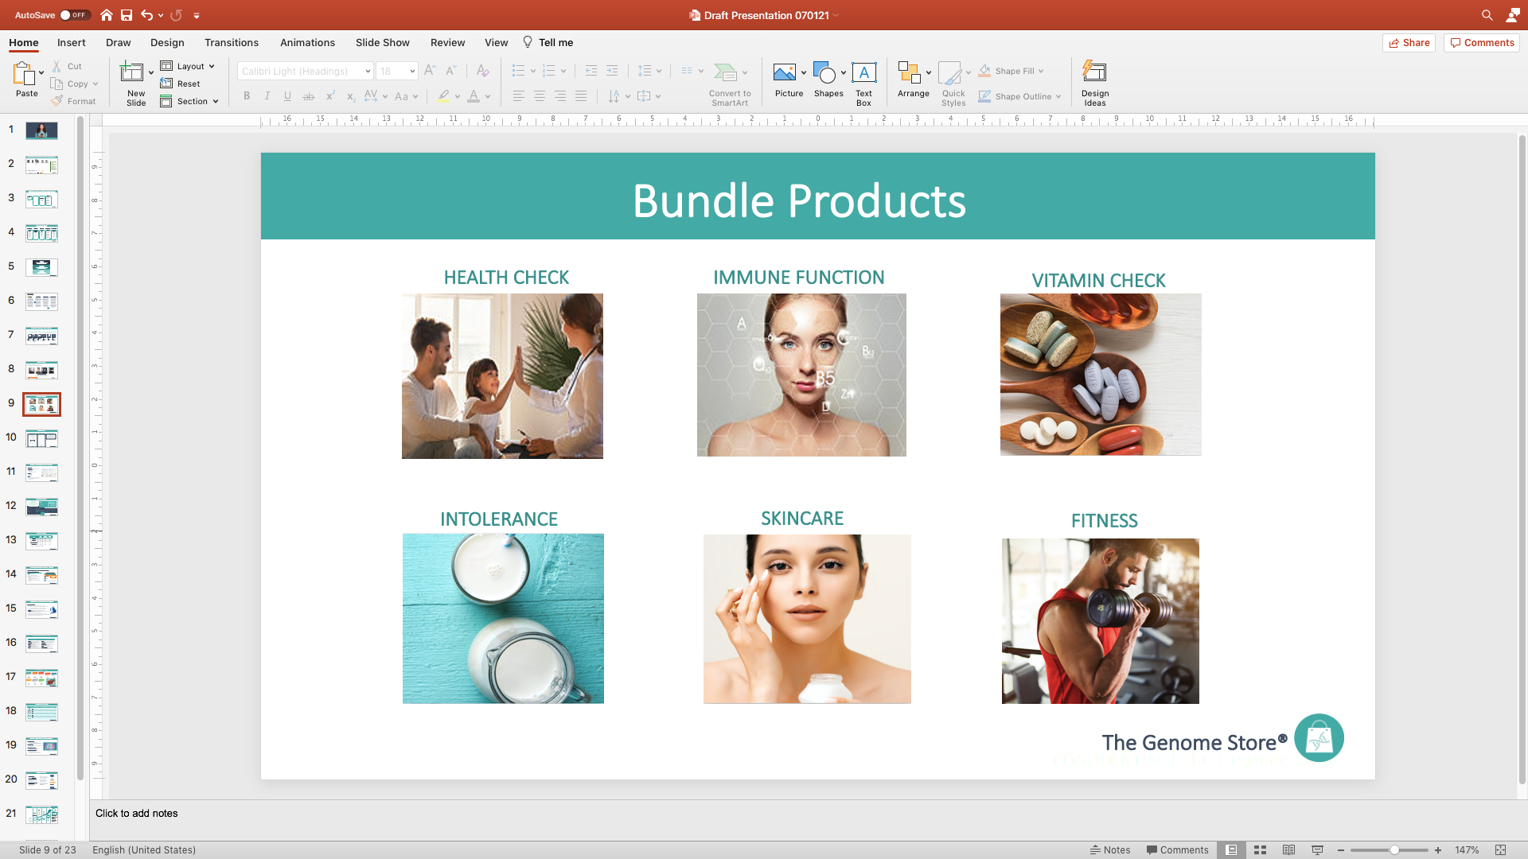
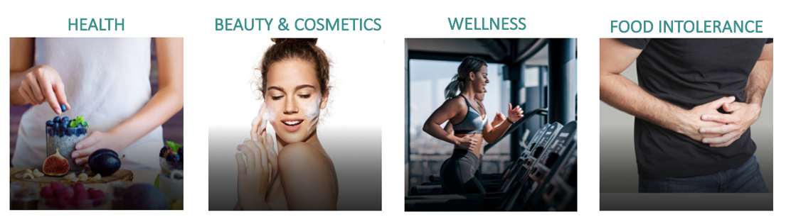
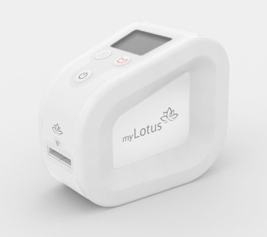
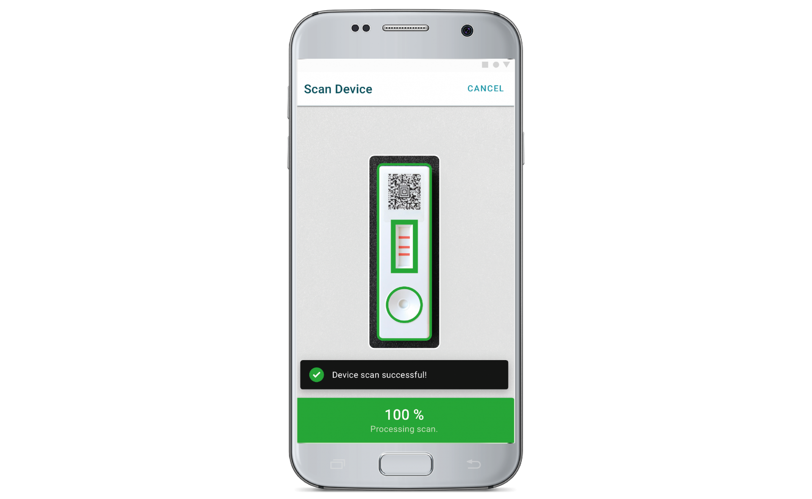


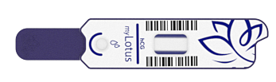
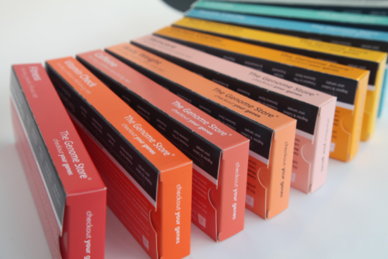
Today we’re here to invest in and grow our at-home testing business
From here
To unlocking a greater opportunity
Fertility
Single
Platform
MULTIPLE PLATFORMS Lateral Flow DNA + more
2
Tests
LIMITLESS TESTS
640,000 UK women successful conceptions to birth in 2019
Multi sector approach opening the door to the $16bn* at home testing market for MHC
6
*Data Bridge Market Research Nov 2020, Global At-Home Testing Kits Market Report https://www.databridgemarketresearch.com/reports/global-at-home-testing-kits-market

Slide 7
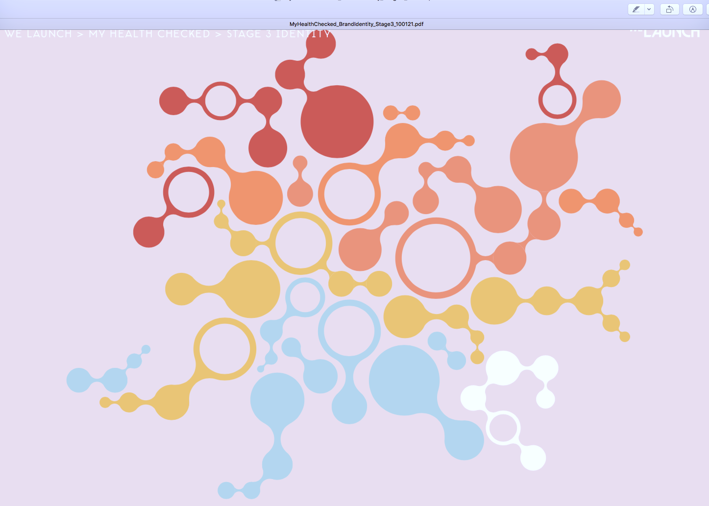

We have a simple, affordable value proposition:
“Here at MyHealthChecked, we aim to help you understand just where you stand, health-wise.
With a developing range of options from private COVID testing (launched Dec 2020) to insight into intolerances and genetic predispositions, we promise clarity, accuracy and service you can trust, at prices you can afford”.
7
Notes:
498633

Slide 8
Evolution into the significant opportunity of DNA testing
DNA testing is being used increasingly as an indicator of your biology by the industry at large
CAGR for at-home testing kit market is 6.8%, from $8.87bn in 2019 to $16bn by 2027*
Direct-to-Consumer Genetic Testing Market to hit $2.5 Bn by 2024 (Global Market Insights, Inc)
Addressable market: Market experts Deloitte found that 40% of study participants are comfortable using at-home diagnostics**
Lactose Intolerance
15%
10m
people
Gluten Intolerance
13%
8.6m
people
Osteoarthritis
10%
6.6m
people
£756m addressable
UK market***
40% = £302m
Attractive 50% GM
+
+
=
Based on Deloitte’s findings, the addressable market of 3 high prevalence health conditions alone with a receptive customer base represents significant margin potential
*Data Bridge Market Research Nov 2020, Global At-Home Testing Kits Market Report
**Deloitte Center for Health Solutions 2020 Survey of Health Care Consumers, May 2020
***Average price of £30.00.
8
CONFIDENTIAL | The Genome Store

Slide 9
Genomics & genetic testing: a new mainstream for the 21st century
At-home Genetic testing was in its infancy 10 years ago
‘’We’re no longer forecasting change – we’re watching it happen’’.
¹Thomas Barlow, GIMR, 2018
It’s an early and exciting time to be moving into this dynamic space
In the last decade >£1 Billion has been
invested in human genomics companies which has
coincided with:
a greater consumer understanding
a relaxation of the regulations to allow testing
and reporting
technological advancements which have allowed
lower costs
Exponential growth over the next 3 years
2020
Prime time to become involved in the genetic testing market
³# Genetic Tests Per Year (2009 – 2023)
https://www.sciencedaily.com/releases/2018/05/180504103811.htm
¹Science Daily: Genomics is disrupting the healthcare sector
A landmark report unveils wide-ranging clinical and commercial impacts of low-cost DNA sequencing and analysis (May 2018)
https://www.technologyreview.com/2019/02/11/103446/more-than-26-million-people-have-taken-an-at-home-ancestry-test/
³MIT Technology Review: More than 26 million People have taken an at home ancestry test. (Feb 2019)
https://www.ncbi.nlm.nih.gov/pmc/articles/PMC5987210/#:~:text=As%20of%20August%201%2C%202017,tests%20were%20single%2Dgene%20tests.
Health Aff (Millwood). 2018 May; 37(5): 710–716.
Genetic Test Availability And Spending: Where Are We Now? Where Are We Going?
Genomics market
https://www.fortunebusinessinsights.com/industry-reports/genomics-market-100941
https://www.marketsandmarkets.com/Market-Reports/genomics-market-613.html?gclid=CjwKCAiAudD_BRBXEiwAudakX8VQgL0j1dfJoHaxoth64l9c9A7mY1_Iqt_2WIB9KZHdsg3W0H4BqBoCFHgQAvD_BwE
9

Slide 10
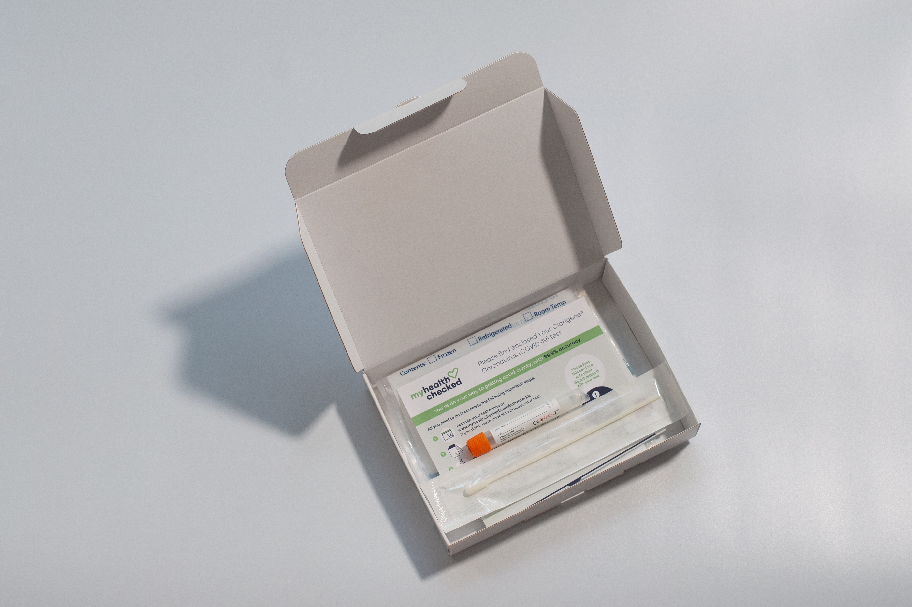
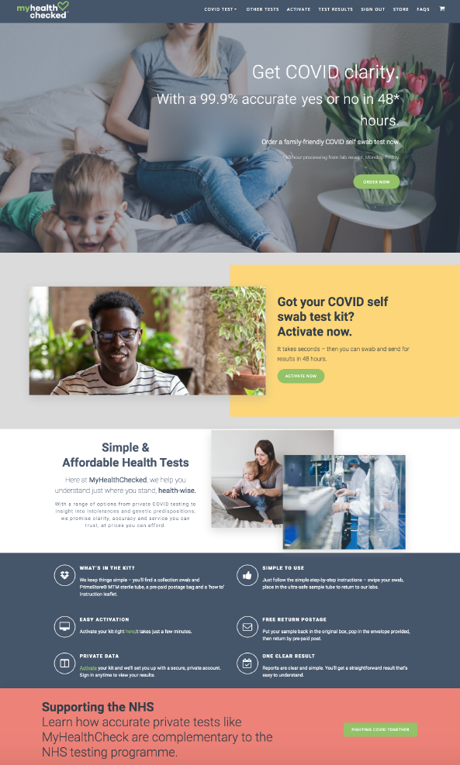
Now: Home testing is a growing market with significant white space due to
Change in mindset
COVID-19 making home testing more desirable and expected
Behaviour changing
avoidance of physical attendance for many interactions – remote communication the new normal
Familiarity
with online purchasing of tests – now moved beyond fertility and diabetes
Understanding
that overall general health can impact susceptibility
Preventative mindset
thinking ahead and proactively avoiding/preparing
Affordability
realistic pricing will drive adoption, no need to ‘go private’
MHC COVID-19 test launched Dec 2020
“The COVID-19 pandemic has turned the healthcare system upside down and challenged consumers' sense of well-being, according to the report. In other words, consumers are taking charge of their health more than ever before” – Deloitte ‘Are consumers already living the future of health? – May 2020
*https://coronavirus.data.gov.uk/details/testing 14.1.21
**McKinsey & Company, COVID-19 and in vitro diagnostics: New market forces at play – Dec 11, 2020
10

Slide 11



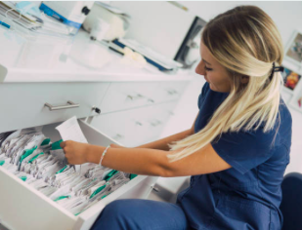




2021 and 2022 product discovery targets
INTOLERANCE
FEMALE
REPRODUCTIVE HEALTH
Pre-Pregnancy & Pregnancy
Folate
Homocysteine
Vitamin B6
Vitamin B12
Iron
Vitamin D
FEMALE HEALTH
Osteoporosis
Osteoarthritis
NUTRITION
(DEFICIENCY RISK)
Vitamin A
Vitamin B
Vitamin B12
Vitamin C
Vitamin D
Folate
Vegan
SKIN & BEAUTY
Collagen
Wrinkles (premature aging)
Acne
Glycation
Stretch Marks
Skin Bruising
Hyperpigmentation
Sunburn
Lactose
Coeliac
Alcohol
Caffeine
Sugar
NUTRITION
INTOLERANCE
VIRUS
VIRUS
COVID Infectivity
COVID Severity
Flu Susceptibility
INTIMATE HEALTH
INTIMATE
HEALTH
Bacterial
Vaginosis
ADDICTION
Smoking
Alcohol
Food
Opioid
REPRODUCTIVE
SKIN & BEAUTY
FEMALE HEALTH
ADDICTION
Pipeline to be timed to accommodate immediate covid- growth opportunities, and assessed using our internal scorecard and Gateway process
All pipeline tests developed in-house by MHC’s experienced team. New tests alongside Yourgene’s Clarigene (covid PCR), Abingdon’s App Dx (Mylo) and EKF’s Primestore MTM technology
11

Slide 12

Driving a dynamic roadmap ahead
Delivering multiple product launches in 2021 and beyond to update the stock market with progress and key milestones
Feb 21
Investment
Up to £3m
Oct 20
Detailed
Strategy
planning/M&A
evaluation
Nov 20
TGS
Acquisition
Dec 20
Covid test
Launch
Govt approval
Jan 21
Campaign
builds
Feb 21
ISO 15189*
Mar 21
Retail
discussions
Apr 21
Phase 2
Launch
Jul 21
Phase 3
Launch
Oct 21
Retail
Launch
Phase 4
Launch
Mar 22
Phase 5
Launch
Mobile App
Jun 22
Product
recommendations
Jul 22
Phase 6
Launch
* Anticipated audit date UCAS to confirm
12

Slide 13



How our tests are different
At MyHealthChecked our tests:
Deliver results fast – days not weeks
Are priced attractively - £20 - £30 for core single range (aside from Covid tests)
Use scientifically validated, highly significant genetic markers
Are based on published evidence in the most up-to-date literature
Can use markers that account for global populations (i.e. gender, ethnicity)
Digitally deliver simple, manageable outcomes and advice
How do we do this?
Our choice of technology (PCR and fragment analysis) alongside our proprietary, optimised laboratory workflows allows for flexibility and test adaptability that most of the competition are unable to offer.
How is this different to our competitors?
Some competitors such as 23&me, DNAfit, and Vitl utilise an ‘off-the-shelf’ microarray technology for their test, which encompasses a fixed number of markers** which ultimately limits marker selection.
*uses microarray for DNA health tests only (not genetic intolerance)
**<1% of the markers identified in the human genome by 1000 Genomes Project in 2015
13
Notes:
The ‘off-the-shelf’ microarray is supplied by Illumina, who upgrade their array every few years (currently on version 3) – NOTE – when new version arrive 23&me sell new tests to currents users for the extra info. i.e. genetic predisposition toward having dandruff in 2019 from version 3 array for $79.
Illumina Global Screening Array: Fixed markers: ~ 654,027
Custom marker add-on capacity: Up to 50,000
1000 genomes project is 2015 had validated >80 million of the known 100 million in the dbSNP catalogue
The Array is therefore less than 1% of the known markers in the human genome

Slide 14
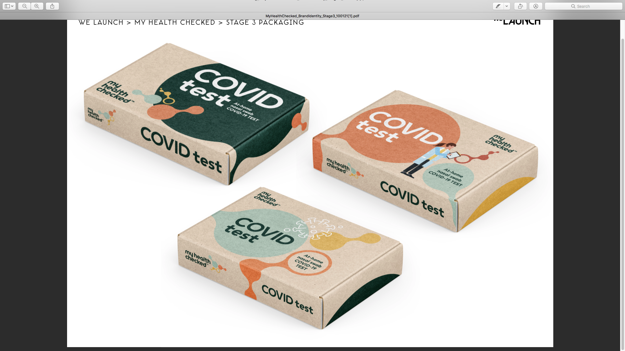








Agile, flexible, and able to react
Our fully flexible testing model allow us to be market reactive, whilst cost effective
For Example:
COVID-19 Severity
A genome wide association study involving 1980 patients with COVID-19 and severe disease (defined as respiratory failure) has been conducted at seven hospitals in the Italian and Spanish epicenters of the SARS-CoV-2 pandemic in Europe. LaCAR have launched a CE-marked diagnostic laboratory test that uses the same SNPs
The New England Journal of Medicine (Oct 2020)
Available for use in diagnostic laboratory
COVID-19 Infectivity (Susceptibility)
Host-mediated lung inflammation is present, and drives mortality, in critical illness caused by COVID-19. The results of the Genetics Of Mortality In Critical Care genome-wide association study in 2244 critically ill COVID-19 patients from 208 UK intensive care units (ICUs). Results identify robust genetic signals relating to key host antiviral defence mechanisms, and mediators of inflammatory organ damage in COVID-19.
Nature (Dec 2020)
Launching H1 2021
Highly relevant to vaccination market
and BAME communities
Target DTC and retail
Ahead of the curve
COVID-19 Infectivity | OAS3 | P | P | P | P | P
 | IFNAR2 | x | x | x | P | P
COVID-19 Severity | SLC6A20 | x | x | x | P | P
 | LZTFL1 | x | x | x | P | P
 | DPP9 | P | P | P | P | P
Which are accessible currently on utilized tech?
£499
WES
D2C
14
Notes:
WES = Whole Exome Sequencing (type of technology used – comprehensive but very expensive including an expensive and laborious analysis)
Others (23&me, DNAfit, etc) all use – Microarray technology - >600,000 fixed marker (uses Illumina Global Screening Array) – doesn’t those 3 markers

Slide 15

Ability to create superior products
HLA-DQ2.5 | Most common | P | P | P | P
HLA-DQ8 | Less common | P | P | P | P
HLA-DQ2.2 | Least common | x | x | P | P
Coeliac Disease
Tests with 99% accuracy are brought to market by trusted, accredited, approved provider
Intolerance Range
Our skilled team identifies the most accurate, proven up-to-date evidence base which enables us to bring the most relevant markers into our portfolio
This allows us to offer a clinically evidenced, meaningful panel, and support it with references to provide an accurate picture of the customer’s genetic make-up
TNF-α | Common PCOS features such as hyperandrogenism, increased insulin resistance and obesity | P | P
IL-6 | Inflammation | P | P
DENND1A | Metabolic Dysfunction affecting 33% of women with PCOS | x | P
THADA | Androgens and Gonadotrophins dysregulation | x | P
Polycystic Ovarian Syndrome (PCOS)
Note: Supreme fertility assess other related markers as part of their PCOS assessment likely due fixed markers
Female Reproductive Health
15

Slide 16
Why customers will choose MyHealthChecked
Affordable
premium products and service at affordable prices
Driven in-house with
cherry-picked specialists to target and engage users via:
Paid search
Content (organic traffic key)
Influencers connected to target user groups
PR/backlinking to relevant sites
Broadening reach
Clear messaging and retargeting
Targeting non-adopters
Simple
clear, actionable results
from each test
Validated
well established by scientific experts, supported by publications
DNA Insights
Opt-in, pseudonymized DNA bank for learnings & development
Trust us
tested by our experts
Customisable
a fully customizable ‘pick and mix’ testing service, allowing the customers to select the test or tests they’re interested in from our store
Skilled team
Samples are processed in our laboratories by highly trained team of scientists
High accuracy tests
All of our tests are
>99% accurate
16

Slide 17

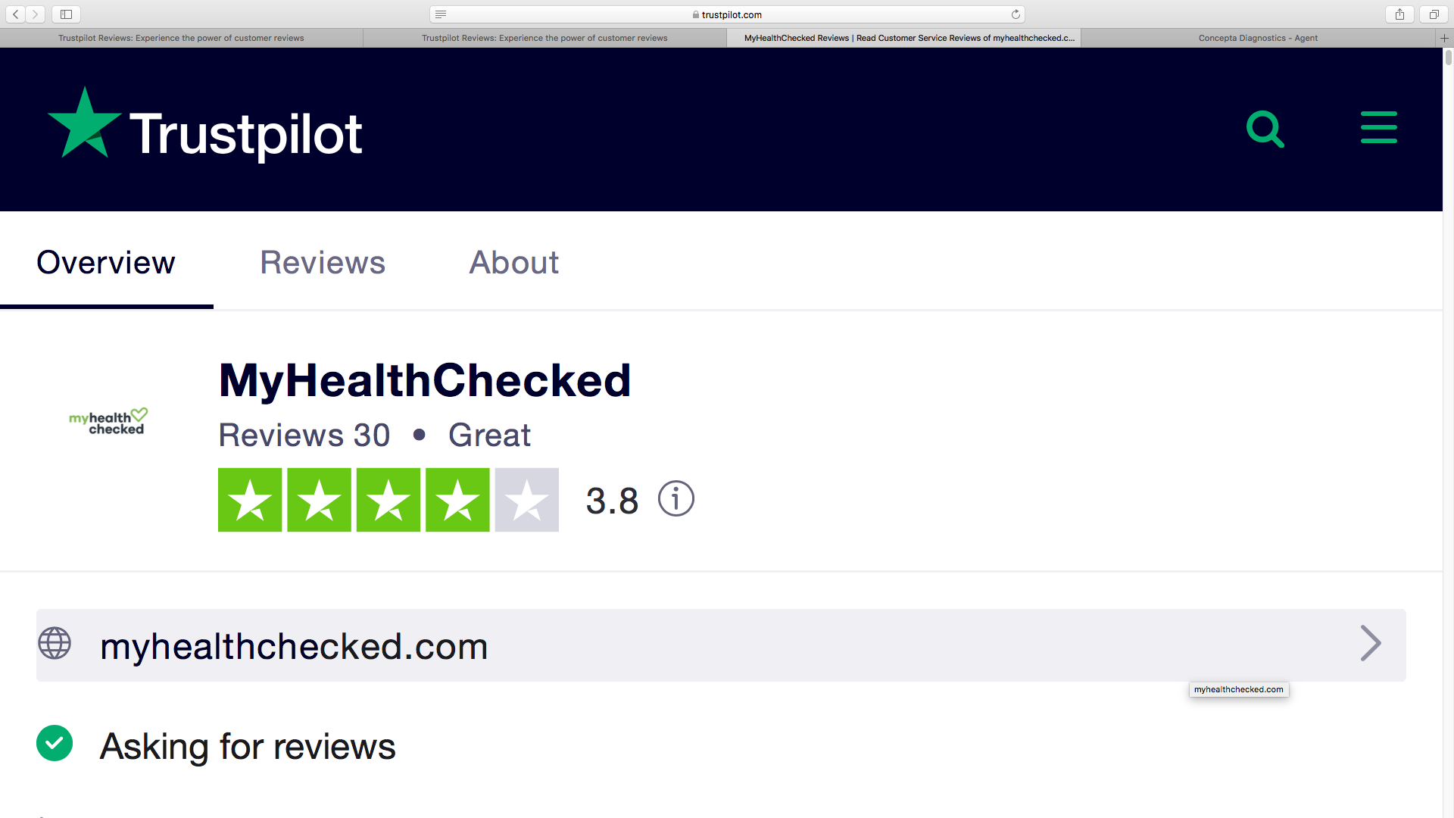
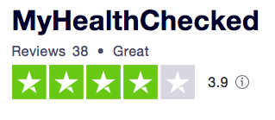
We have created and commenced delivery of these market opportunities
Milestones delivered:
Growth outcomes:
P
New management team
DTC revenue generation
Cash preservation
Investment in M&A
Relationships
Endorsement of brand
Reach
Full regreening of team under new leadership
Launch of business and commercialisation
Refocused the business through adjustment to a partnership model
Acquisition of The Genome Store to open channels. Securing of global App Dx license – development underway
Established relationships & partnerships with high calibre UK diagnostics businesses: EKF, Abingdon Health, YourGene
Achieved Government approval for official Test to Release Programme
Over 1m people in the UK Dec 2020 via leaflet drop and regional radio
P
P
P
P
P
P
Trustpilot as critical. 38 reviews achieved over 6 weeks. Engagement and follow-up drive to nurture engaged customers. KPI to secure >10 reviews a week from Feb 1st 2021
17

Slide 18
Initial potential for pipeline development: UK
Test | Prevalence* | Units | Addressable market | 0.5% share | 1% share | 5% share
Lactose | 15% | 9.9m | £297m | £1.5m | £3m | £15m
Gluten | 13% | 8.6m | £258m | £1.3m | £2.6m | £13m
Caffeine | 10% | 6.6m | £198m | £1m | £2m | £10m
Alcohol | 7% | 4.6m | £138m | £0.7m | £1.4m | £6.9m
Osteoarthritis | 10% | 6.6m | £198m | £1m | £2m | £10m
Pre-pregnancy | Births + TTC (1 in 6) | 0.8m | £23m | £0.12m | £0.23m | £1.1m
 |  |  | £1.11bn | £5.6m | £11.23m | £56m
We have the potential to own an increasing % of the addressable market by competing with the competition on quality and price, and capturing new adopters
50% margin
GROWING MARKET: 2020 - 2027: 6.8% CAGR
* Based on a UK population of 66m
18

Slide 19
Our 3-year horizon
2021 | 2022 | 2023
Intolerance, Women’s Health, Fertility Web App development DTC, Amazon, Retail UK | + Healthcare, Beauty (eg: premature aging) Expanding capabilities Mobile App Complimentary product recommendations European Entry (regulations TBC) | + Portfolio B2B Business development: Brands, insurance providers
£1.1bn addressable UK market | £4bn+ addressable market* | £++
* Based on a EU population of 257m
19

Slide 20
Placing, use of proceeds and timetable
We are raising up to £3m investment to
Launch into retail
Build awareness
Develop a pipeline of new products
Develop a Smartphone App and data capture
Broaden our testing capabilities
The investment will fund
An increased headcount from 10 in Jan 2021 to 21 in Dec 2022
The marketing investment required to accelerate growth
The ongoing cost base of MHC through this growth phase
Process
We are applying for Advance Assurance from HMRC that the new shares qualify for EIS and VCT relief (Philip Hare Associates)
We will need to seek authority from shareholders in GM to issue shares
Mercia re-investment, subject to Investment Committee approval
Directors have undertaken to participate in the placing
Timetable
Roadshow (wall crossed) | Monday 25th – Thursday 28th January
Announcement of ABB | 16.30 Thursday 28th January
Close of ABB | 12.00 Friday 29th January
EGM | 16th February
Admission of placing shares | 17th February
Contact Oberon Capital: Mike Seabrook on 0203 179 5344 and Theo McDonnell on 0203 179 5302
20

Slide 21
To conclude
MHC has the right cost base, the right team, the right partners and the right strategy to capture a significant growth market from consumers
P
We are generating revenue with more covid opportunities ahead, whilst developing new products to launch in 2021 and beyond
P
We have clear strategy for growth and will add products and selectively, acquisitions if they meet our criteria for enhancing stakeholder value
P
We will update the market regularly with developments as momentum builds
P
We are raising money to fast track and develop
P
Thank you
21

Slide 22


Appendix 1: Competitive Products
 | Price | Non Invasive | DNA Based Test | Single Test | Tested in-house | Available on High St | App Access to Data | Concise Reporting | UK Product
 | £ | P | P | P | P | P | P | P | P
 | £££ | P | P | x | N/A | P | P | P | P
 | ££ | x | x | x | N/A | P | P | P | P
 | ££££ | P | P | x | N/A | P | P | x | x
 | ££££ | P | P | x | N/A | P | P | P | x
 | ££££ | P | P | x | P | P | P | P | P
 | ££££ | P | P | P | N/A | x | x | x | P
22

Slide 23
Appendix 2: Population, Prevalence and Perception
Symptoms
Self-diagnose
Interested
Validation
Impulse
reasons
why do you get headaches, feel nauseous, have difficulty putting on weight?
you believe you’re lactose intolerant but have never been tested
what diet is best for you to gain muscle, why does coffee not wake you up
you’ve told friends and family you have this issue and can now prove you do
the tests are inexpensive, right place/right time
Rule-out
Testing
issues
Lifestyle
planning
Affordable & simple
Engage
benefits
negative test rules out the simple answer, seek medical advice knowing it is something else
it can take time, effort and be expensive to be tested
avoid certain foods, don’t drink energy drinks, eat more protein
find out more information, look at products that will help
some tests many times more expensive, complicated results, pseudoscience
23

Slide 24


Appendix 3: Customer Journey - How It Works
Simple Process, <2 weeks to Results
✐
PRODUCT
PURCHASED
REGISTRATION
& COLLECTION
POST TO MyHealthChecked
SAMPLE PROCESSING
DATA ANALYSIS & INTREPRETATION
RESULTS REPORTED
Product purchased online
Customer registers information on website or App & collects sample
Freepost – Royal Mail
Sample registration, DNA isolation and processing
Analysis of results
Reporting via email, website and App
24

Slide 25
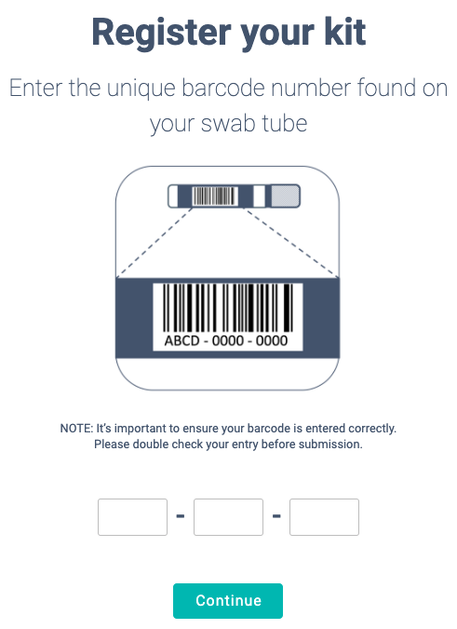
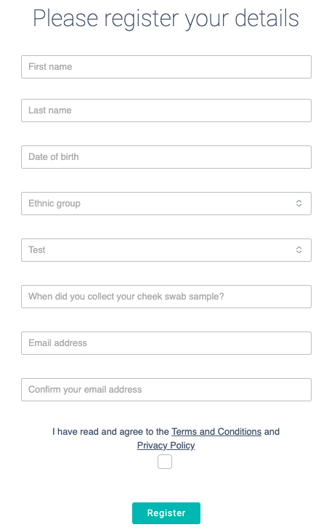

Appendix 4: Product Use
Kit registration is completed via website (App in development)
1. Enter your barcode
2. Submit your details
3. Wait for your user details
25

Slide 26
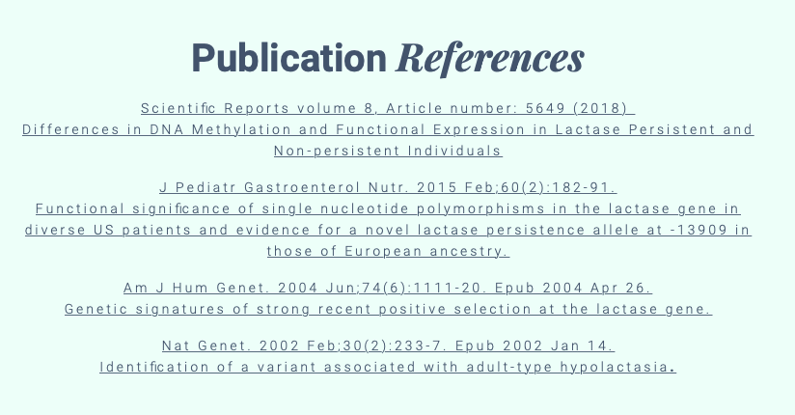

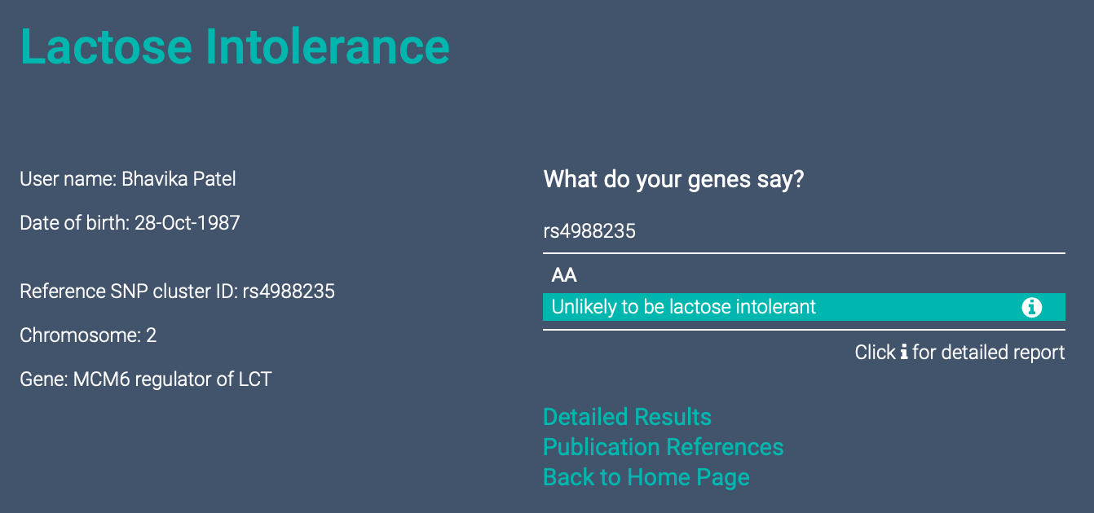
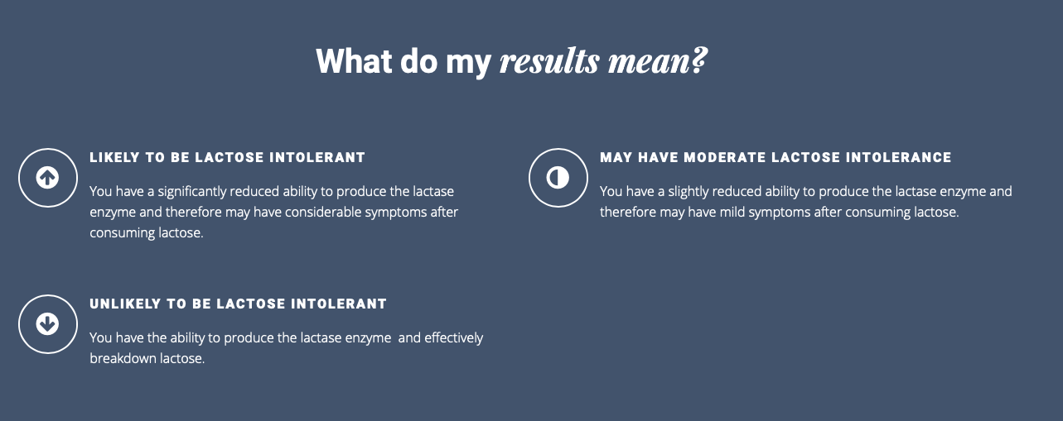

Appendix 5: Customer Results
Joe Bloggs
26

Slide 27
Appendix 6: Financial History
£’000 | 2018 | 2019 | 2020*
Sales | 4.8 | 32.0 | 54.7
Cost of sales | -75.3 | -77.1 | -246.5
Gross Margin | -70.4 | -45.1 | -191.8
Operations | 487.9 | 418.0 | 152.9
Gross Profit | -558.3 | -463.1 | -344.7
R&D | 564.8 | 223.0 | 535.0
Sales and marketing | 216.9 | 588.2 | 448.1
Administration | 1,065.7 | 749.6 | 733.2
 | 1,847.5 | 1,560.8 | 1,716.2
Operating Profit | -2,405.8 | -2,023.9 | -2,060.9
PLC | 460.0 | 471.0 | 485.4
Net profit | -2,865.8 | -2,494.9 | -2,546.3
Depreciation | 338.1 | 236.0 | 157.2
EBITDA | -2,527.7 | -2,258.9 | -2,389.1
 | 2018 | 2019 | 2020*
Cash balance | £740 | £616 | £461
Funds raised (net proceeds) | £1.9m | £2.2m | £1.7m
27
* Draft and unaudited

Slide 28

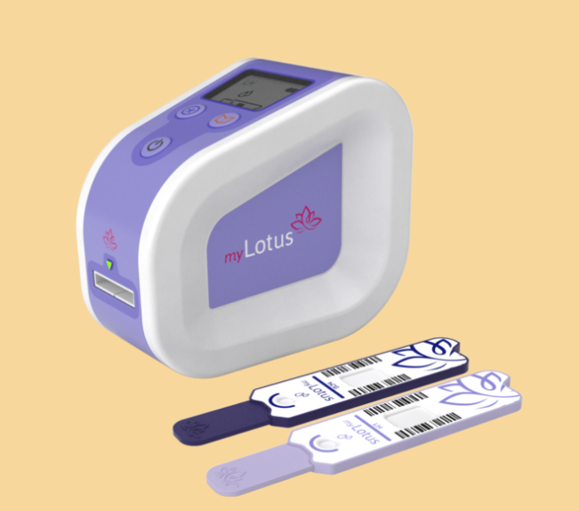
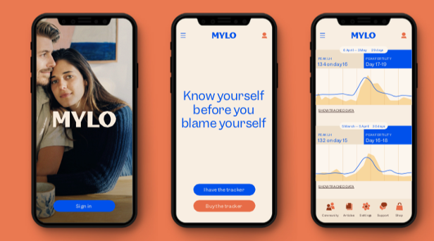
Appendix 7: Our legacy fertility portfolio
Quantitative lateral flow technology for key fertility hormones, under development with PdG test capability and Smartphone reader
Market presence upon which to add highly relevant testing platforms (PCOS, pre-fertility)
Adjusted strategy as Covid impacted model – consumer uncertainty; HFEA guidance; priorities elsewhere for pharmacy retail
Redirecting funds into immediate revenue streams
Substantial progress made in 2020: transition to stronger UX and connectivity
Further development to be supported by grant or JV, enabling us to invest fully in immediate revenue generation - The application to be made according to the defined project
28

Slide 29
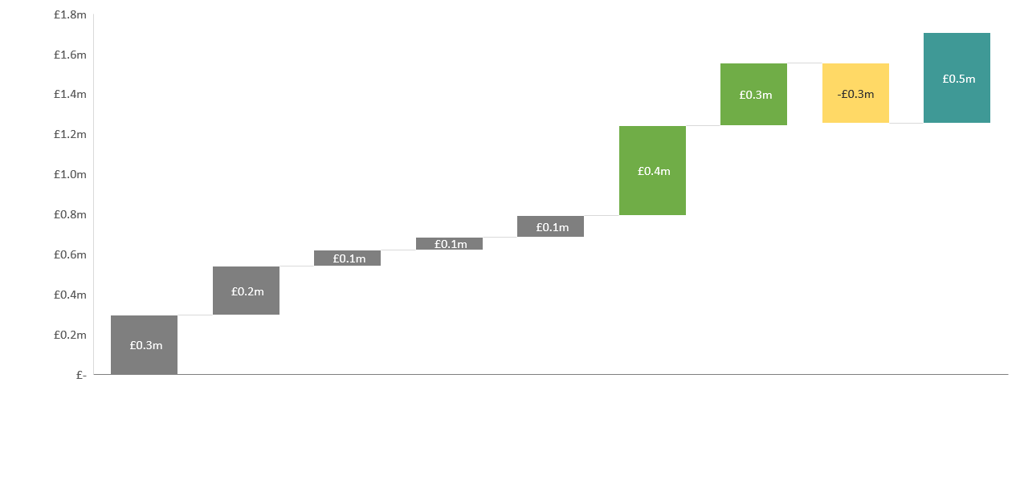
Appendix 8: Corporate use of funds
Re-established Mylo as relevant and correctly positioned
Secured future tech and commenced improvements and development
Adjusted strategy as Covid impacted model
Market-responsive to accelerate revenue in light of pandemic
Technology transfer to contract manufacturer
Plc costs
Lease assignment to contract manufacturer
Cash in hand
V3 assessment and development
H&T legacy to enable V3 development
Mylo marketing and brand development
General, finance and administration
AppDx licence and development of technology
29

Slide 30
Appendix 9: Corporate Information
Shareholder | Ordinary Shares | Issued Share Capital (%)
Share Nominees LTD (Mercia EIS Fund)* | 62,500,000 | 12.1
Mercia Investment Plan LP* | 59,336,428 | 11.5
Hargreaves Lansdown (Nominees) Limited | 39,126,507 | 7.6
W B Nominees Limited | 37,882,420 | 7.3
Barnard Nominees LTD | 36,705,704 | 7.1
JIM Nominees Limited | 36,152,484 | 7.0
CGWL Nominees Limited | 24,787,298 | 4.8
Aurora Nominees Limited | 19,260,910 | 3.7
Interactive Investor Services Nominees Limited | 18,341,182 | 3.5
Lawshare Nominees Limited | 16,647,853 | 3.2
Vidacos Nominees Limited | 13,656,496 | 2.6
Finance Yorkshire Limited* | 12,699,967 | 2.5
Mercia (General Partner) Limited* | 12,375,000 | 2.4
*The total holding for Mercia Asset Management includes
Share Nominees Limited (Mercia EIS Fund)
Mercia Investment Plan LP
Finance Yorkshire Limited
Mercia (General Partner) Limited
Issued share capital = 521,821,675 ordinary shares
Market cap = £10.6m @2.05p
28.4%
30

